Slide 1


Hardware Acceleration of FISTA for Compressed-Sensing Ultrasound Reconstruction
Tofic Esses, Ziv Behar

Slide 2
Agenda
Traditional Ultrasound
Ultrasound for Spatial Imaging
What is Compressed Sensing?
Ultrasound Image Reconstruction
FISTA
Why it matters: Applications
Compute Bottleneck
Goal: Domain-Specific Compute

Slide 3
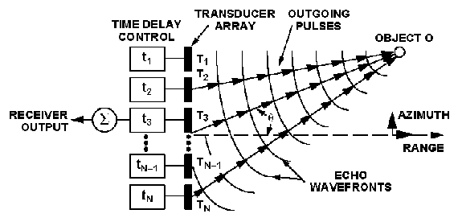
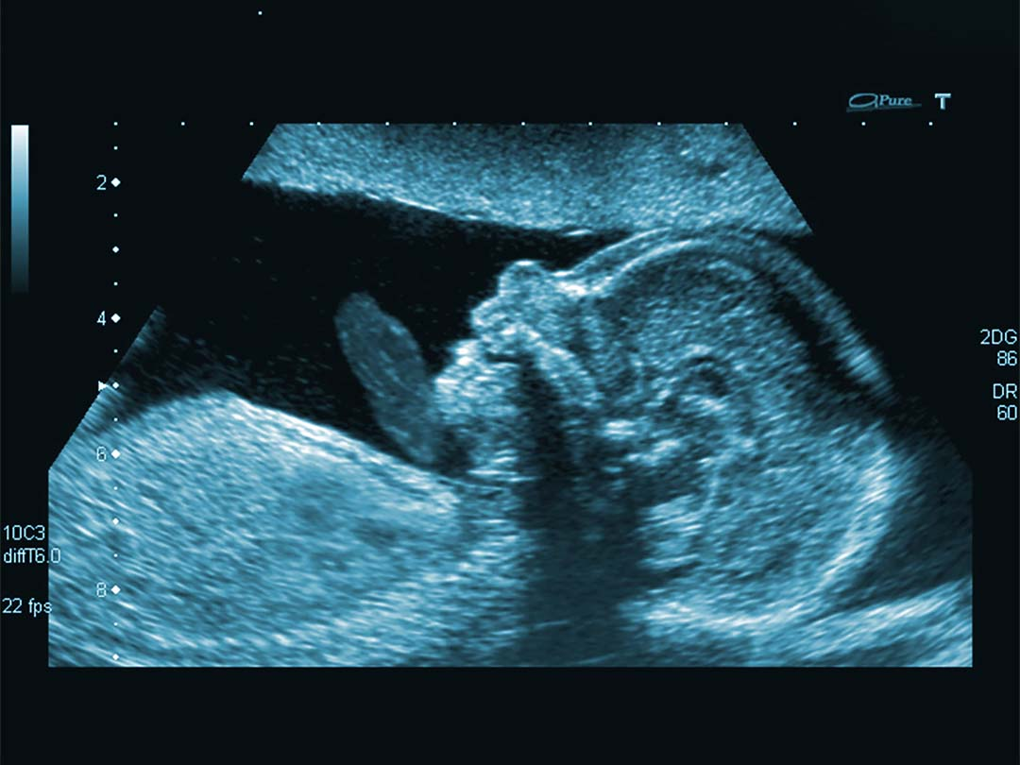
Traditional Ultrasound
Used in medical imaging with beamforming

Slide 4
Ultrasound for Spatial Imaging
What if instead we transmitted non-coherent ultrasound waves: various frequencies, time delays, and positions?
  Fewer transducers -> smaller form factor, reduced cost
  Fewer samples -> less time taken during TX/RX
But how can we reconstruct an image?

Slide 5
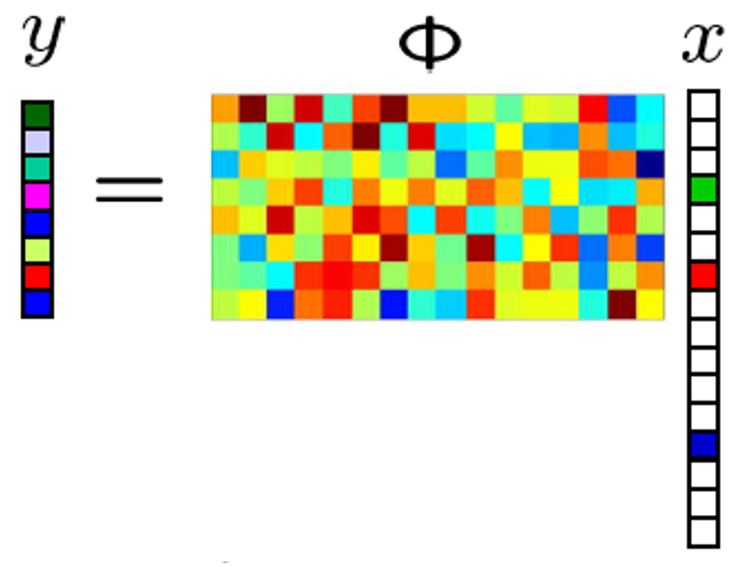
What is Compressed Sensing?
Review
A signal processing technique that enables the reconstruction of sparse or compressible signals from significantly fewer samples than required by the Nyquist-Shannon theorem
A
Underdetermined System
Measurement Vector
(data from ADC)
Sensing Matrix
(determined from simulations -
Aka. forward model)
High-Dimensional Signal
Image to be Reconstructed)
(

Slide 6

Ultrasound Image Reconstruction
Review
Represent 3D space as a cluster of boxes (a.k.a voxels)

Slide 7
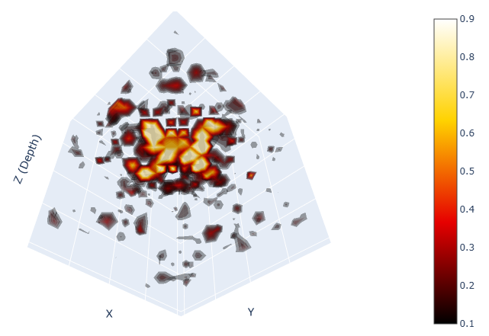
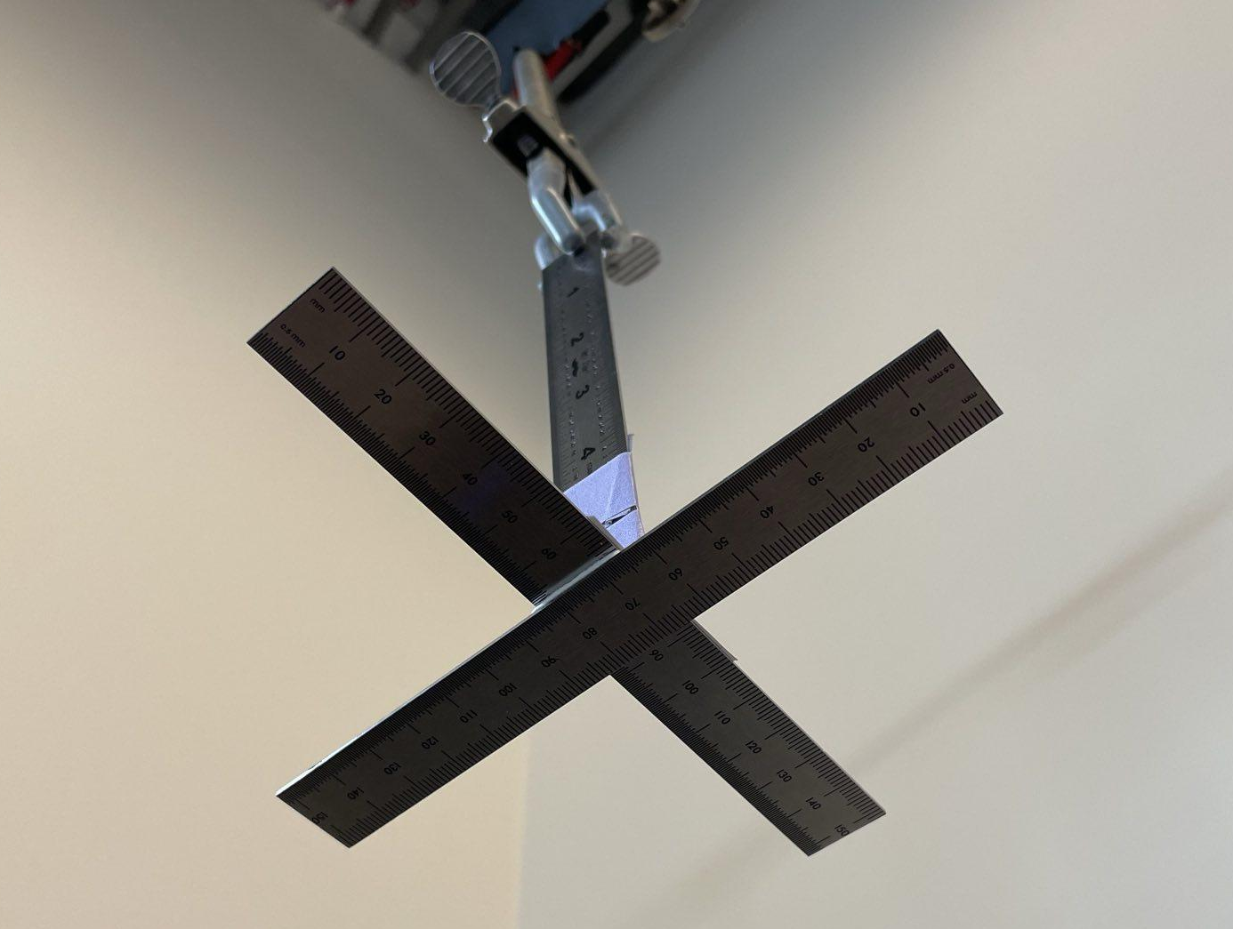
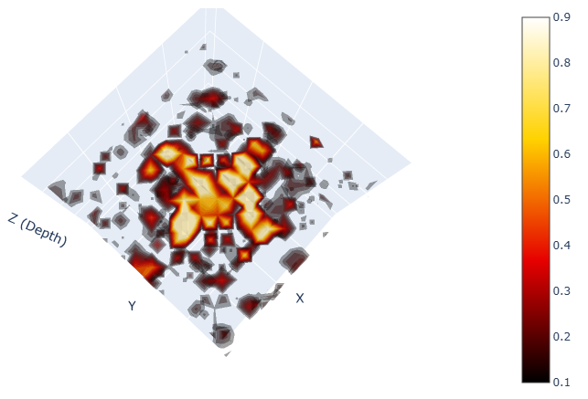
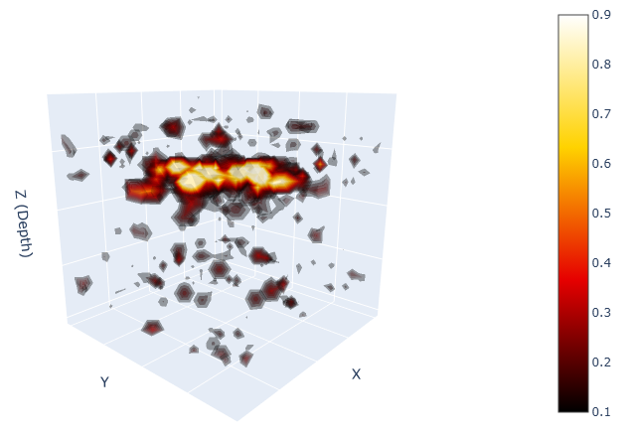
Reconstruction (20 acquisitions)
Review
“Ground Truth”

Slide 8
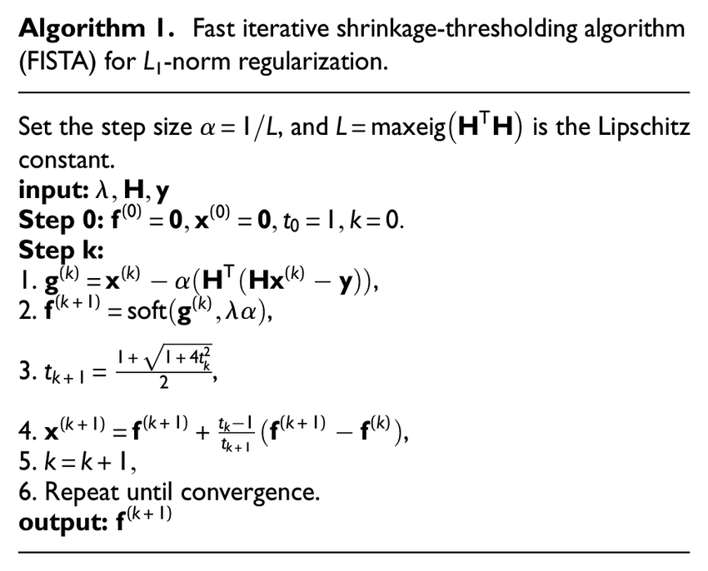
Convex Optimization: FISTA
Review
= Fast Iterative Shrinkage-Thresholding Algorithm
Used for sparse matrix operations
Calculates gradient
Removes small coefficients to enforce sparsity
Updates momentum for fast convergence
Extrapolate
Iterate step

Slide 9
Why it Matters: Applications
Faster acquisition time
Cheaper hardware
Smaller form factor
=
Cost competitive imaging system for robotic applications

Slide 10
Compute Bottleneck
FISTA is an iterative solver (takes time for solution to converge)
The A matrix is very large memory bandwidth problem
Not suitable for real time applications unless compute and memory bandwidth is significantly sped up. Batch processing?

Slide 11
Project Goal: Domain-Specific Compute
Accelerate FISTA algorithm with specialized memory hierarchy, memory controller, and compute
Timeline
Profile compute and memory access patterns of the FISTA iteration (A, Aᵀ, shrinkage, vector ops)
Design an RTL accelerator for the FISTA iteration kernel (datapath + control + memory interface)
Integrate the accelerator into Chipyard and connect to Rocket core
Evaluate performance and memory behavior using FireSim

Slide 12
Project Goal: Domain-Specific Compute
Target Metrics
Execution cycles / latency
Speedup vs CPU baseline
Memory bandwidth utilization
Convergence vs iteration budget
Baseline / SOTA: Software FISTA running on Rocket core
Evaluator: RTL + full-system simulation in FireSim
Required Tools: Chisel, Chipyard, Firesim

Slide 13
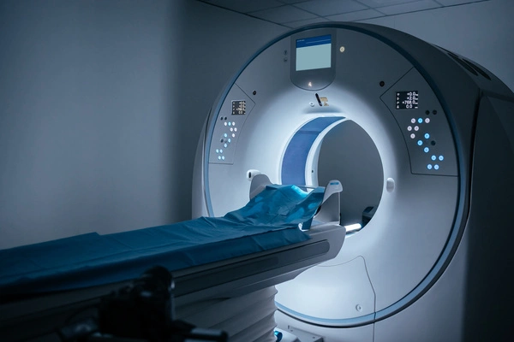
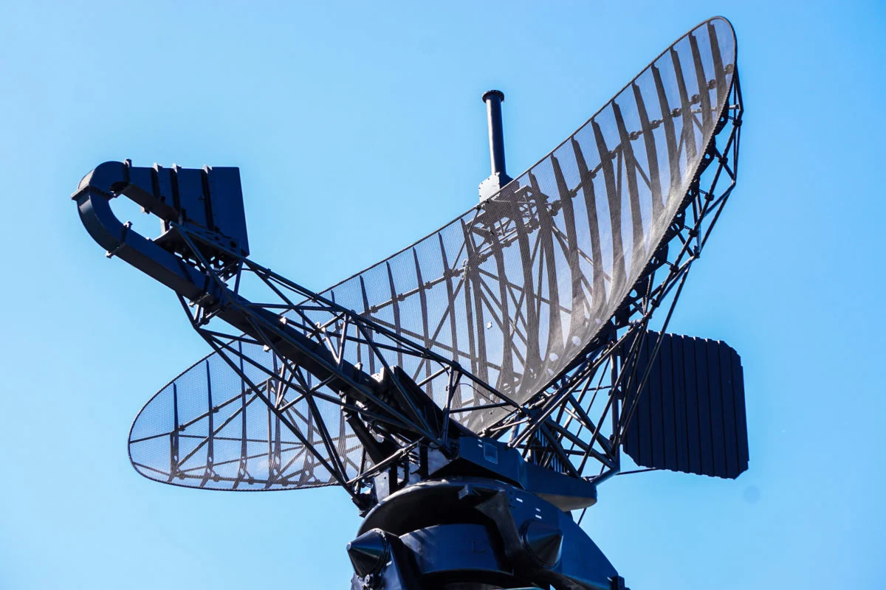
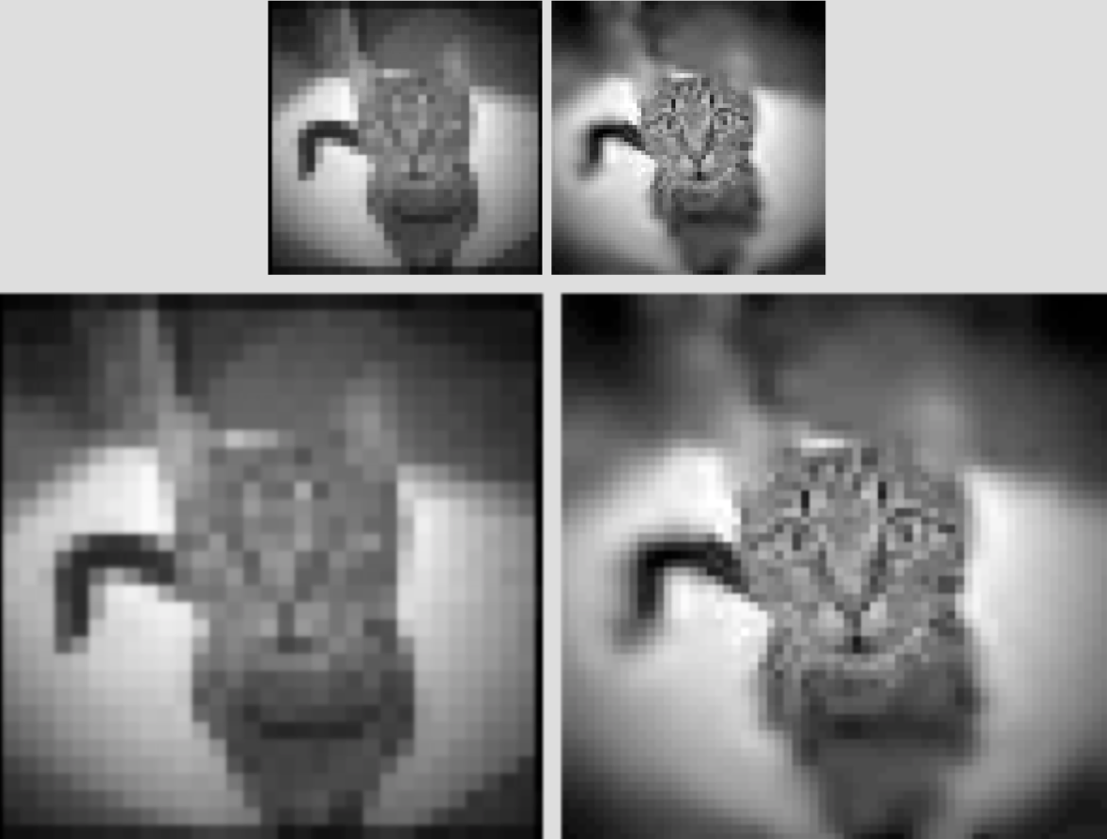

Project Goal: Domain-Specific Compute
Not just applicable to Ultrasound - all types of signal processing

Slide 14
Thank you

